Slide 1
GPS Workshop on allyship
Intro
Welcome from Professor Sara Lombardo (Heriot Watt), Chair of the LMS Women and Diversity in Mathematics Committee
Definitions, etc. from Calvin James Smith (Reading), Co-chair of GPS
Professor Tyler Kelly (QMUL): Finding your initiative in LGBTQ+ inclusion in Mathematics
Professor Simon Chandler-Wilde (Reading): Allyship: experiences on the gender and LGBTQIA+ fronts in the mathematical sciences and beyond
Close

Slide 2
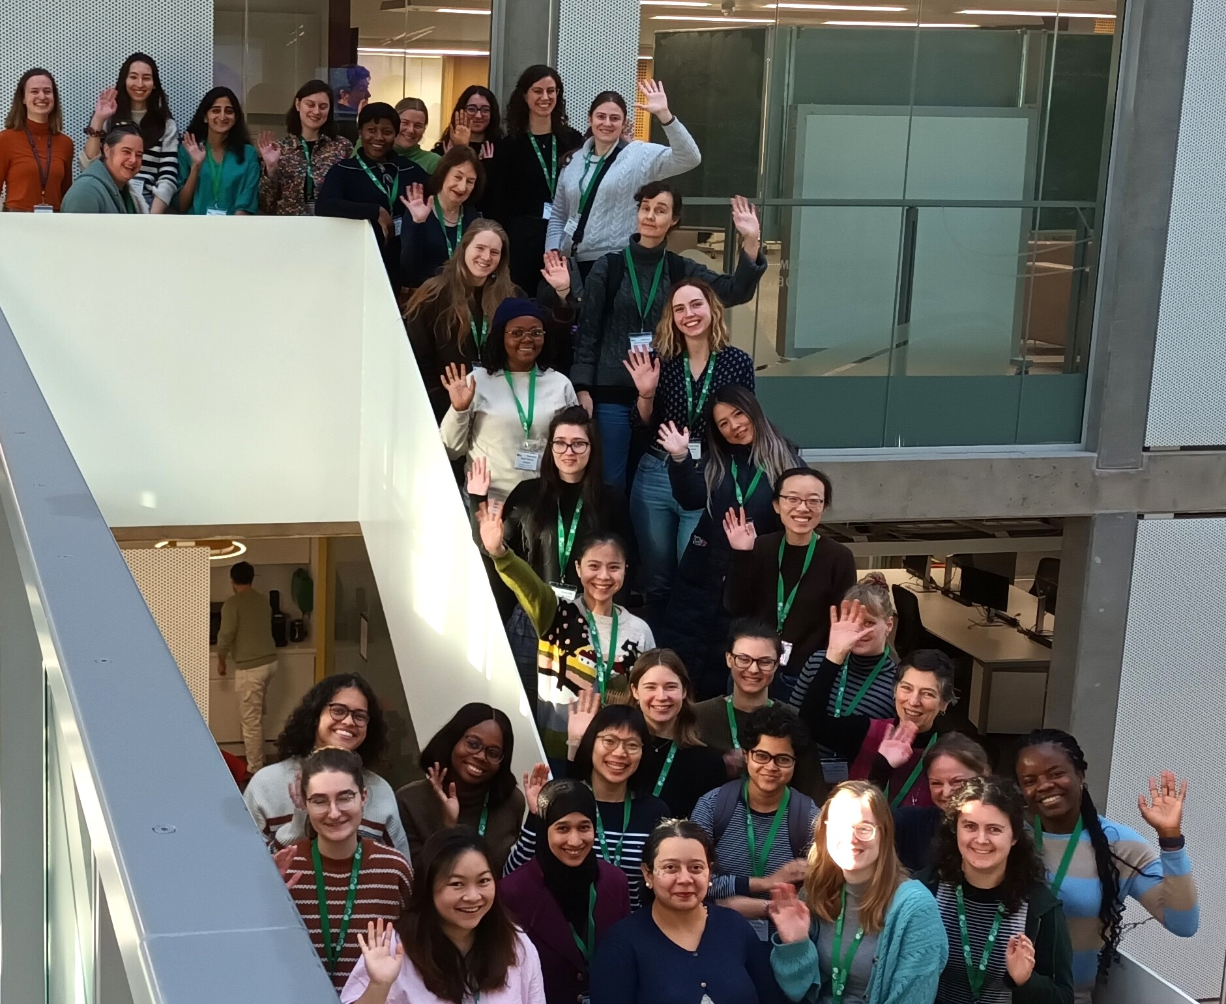
LMS
Committee for Women & Diversity in Maths

Slide 3
About the LMS
The London Mathematical Society has, since 1865, been the UK Learned Society for the advancement, dissemination and promotion of mathematical knowledge. Our mission is to advance mathematics through our members and the broader scientific community worldwide.
Back to Agenda

Slide 4
About the Committee
The second Society Objective recites:
Equity, Diversity and Inclusion – In all the Society’s activities, to recognize, welcome and promote diversity in the mathematical sciences community both in the UK and internationally, though an open, inclusive, respectful, and accessible approach.
The LMS Committee for Women & Diversity in Mathematics is a Committee of Council.
Its purpose is to promote the objectives of the Society in relation to ED&I.
Back to Agenda

Slide 5
The Committee
provides information on items relating to gender and broader diversity in Mathematics;
organises the Mary Cartwright Lecture;
supports and develops workshops and events to promote diversity;
investigates and implements measures pertaining to the retention of women and members of other diversity groups in the mathematical community;
It liaises national and internationally with organisations with similar priorites.
The Committee

Slide 6
The Committee operates several grants schemes:
Caring Supplementary Grants
Emmy Noether Fellowships
Grace Chisholm Young Fellowships
Events supported by the Committee include the annual
Mary Cartwright Lecture and
Good Practice Scheme Workshops
The Committee also provides funding for external events via its
Inclusion and Diversity Fund.
Grants &
Events
Further details:
https://www.lms.ac.uk/about/committees/cwdm

Slide 7
Vibrant, national and international mathematics community
Society events and networking opportunities
Opportunity to sign the Members’ Book, which dates from 1865.
Quarterly newsletter and regular LMS e-Updates
Opportunities to influence national policy
Full voting rights in Society elections
Verblunsky Members’ Room at De Morgan House, Russell Square, London
Free online subscriptions to selected journals
25% discount on LMS Lecture Note Series and LMS Student Texts
Discounted membership of the European Mathematical Society and the Journal of the European Mathematical Society
LMS Library at UCL
Join the LMS
Apply online: lms.ac.uk/membership/online-application

Slide 8
Some helpful definitions
Lesbian – a woman who is attracted to women, some non-binary people also this term
Gay – a man who is attracted to men, some non-binary people also use this term
Bi – someone who is attracted to more than one gender
Trans – someone whose gender is not the same as the sex that they were assigned at birth
Queer - no single agreed definition, but usually defined by its difference to the dominant heterosexual and gender confirming group
Questioning – someone who is in the process of exploring their sexual orientation or gender identity
Intersex – someone who has biological traits of both male and female sexes or whose biological attributes do not sit comfortably with societal or medical assumptions of what constitutes male or female
Ace – someone who typically does not experience sexual attraction

Slide 9
Sex and gender
Sex – biological characteristics used to identify someone as ‘male’ or ‘female’ at birth; differences of sex development do occur, so the use of a binary categorisation is problematic
Gender – a person’s innate sense of being a ‘man’, ‘woman’, ‘non-binary’ or some other description

Slide 10
Allies vs allyship
Ally is not an identity one can passively adopt
Allyship is an active and sustained commitment to support and advocate for marginalised or underrepresented groups
Challenge microagressions
Ask who is not in the room, or not being heard?
Lift up those not in the dominant or power group

Slide 11
UHT: A model for intervention
Understand
However
Therefore
“I understand that you meant no harm by your comment; however, it is offensive to me or others. Therefore, I would appreciate it if you did not do that again”

